Slide 1
RECOMMENDER SYSTEMS · INDIVIDUAL PROJECT
What building a movie recommender taught me
Six methods, one dataset, and three bugs that taught me more than the textbook.
By Yiben
MovieLens Latest Small · 610 users · 9,724 movies · 100,836 ratings
Notes:
One-line framing: this is the story of what building the recommender taught me, not a feature tour.

Slide 2
MOTIVATION
Why movies, and why I cared
I'm a cinephile. I wanted to build a recommender I would actually trust with my own Saturday night.
So my real question wasn't "can I implement six algorithms?" It was: when these models disagree, which one is right and how would I even know?
Movie track · 610 users · 9,724 movies · 100,836 ratings
Notes:
The motivation. The real question wasn't whether I could implement six algorithms — it was how to tell which one to trust.

Slide 3
THE DATA
The starting point
TOO EMPTY
TOO POSITIVE
98.3%
4.0
of the 610 × 9,724 user–movie grid is blank
the most common rating
Most users rated only a handful of films, so every method has to guess from very little. This is what pushed me toward SVD.
Ratings skew high, peaking at 4 stars. The first hint that my test set is not neutral.
Notes:
Two properties of the data shaped everything: it is extremely sparse, and the ratings skew high.

Slide 4
THE DATA
Pre-processing
FILTERED OUT
~50%
01
Merged ratings, movies and tags; dropped rows with missing IDs.
of the catalog has ≤2 ratings. Too noisy for CF
02
CF candidates need ≥20 ratings (MovieLens convention) so obscure one-rating films don't dominate lists.
03
Train on past ratings only; test on each user's future. No leakage.
SPLIT
80 / 20
temporal holdout per user; most recent 20% for test
04
The same cleaned data feeds all six models and the Streamlit app.
Notes:
Preprocessing: from raw CSVs to one cleaned grid that feeds all six models and the app. Filtered noisy films, temporal 80/20 split.

Slide 5
PART 1
Three things that broke
The challenges I hit, what I tried, what I learned.
Notes:
Section break. Three bugs, each one a lesson.

Slide 6
PART 1 · BUG 01
The obscure-movie swamp
WHAT BROKE
WHY
WHAT I TRIED
WHAT I LEARNED
My first collaborative-filtering lists were full of films I'd never heard of. Movies with one or two ratings total.
With that little support, a single agreeing neighbour produces a fake-perfect score. There were a lot of noise.
A minimum-support filter: drop candidates with fewer than 20 ratings from both CF methods.
I chose 20 because half the catalog has two or fewer ratings, so a support floor is needed, and also 20 is the value MovieLens itself uses.
The threshold is a value choice. Raise it and lists get more accurate but more boringly popular. This was my first taste of the accuracy-vs-discovery tension.
Notes:
Bug 1: niche movies with one or two ratings flooded my lists. Fix: a minimum-support filter. Lesson: the threshold is a value choice.

Slide 7
PART 1 · BUG 02
My evaluation was cheating
WHAT BROKE
WHY
WHAT I TRIED
WHAT I LEARNED
Early scores looked great. Too great.
A random split let a model train on a user's future to predict their past, leakage that can't happen in real life.
A temporal split: hold out each user's most recent 20% by timestamp, so I only predict forward in time.
The honest number was lower, and that was the point. An evaluation that flatters you is a lie you tell yourself.
Notes:
Bug 2: a random train/test split let models train on a user's future. Fix: a temporal split. Lesson: an evaluation that flatters you is a lie.

Slide 8
PART 1 · BUG 03
Predictions flew off the scale
WHAT BROKE
WHY
WHAT I TRIED
WHAT I LEARNED
Item-based CF returned predicted ratings above 5 and below 0.5. Impossible on a 0.5-to-5 scale.
Negative item similarities. A negatively correlated disliked movie can swing the weighted formula out of range.
Zero out negative similarities, so the prediction is a clean weighted average of the actual ratings.
A formula copied from the notes isn't done. The textbook version assumes clean data; mine had to survive a sparse, messy grid.
Notes:
Bug 3: item-based CF returned impossible ratings, caused by negative similarities. Fix: zero out negative similarities. Lesson: a textbook formula needs to survive messy data.

Slide 9
PART 2
Six methods, then the surprises
Notes:
Section break. Six methods built from scratch — and the surprises in the results.

Slide 10
THE TOOLKIT
The six, in one breath
01
Popularity
02
Bayesian average
03
User-based CF
Top-N by rating count. The baseline to beat.
IMDb weighting. Stops one 5-star rating from winning.
"People like you also liked…"
04
Item-based CF
05
Content-based
06
SVD
"Because you liked similar movies…"
TF-IDF on genres and tags, with explanations.
Latent factors on the 98%-empty grid.
All six share one interface, model.recommend(user, n), so the notebook and the app reuse the exact same code.
Notes:
The six models, from the popularity baseline up to SVD. All share one interface so the notebook and app reuse the same code.

Slide 11
SURPRISE 1
Reaching wide is not the same as variety
WHAT I EXPECTED
The model that touches the most of the catalog should also give the most varied lists.
METHOD
COVERAGE
DIVERSITY
Popularity
0.012
0.96
Item-CF
0.115
0.90
WHAT I FOUND
Content
0.38
0.22
Content-based has the widest reach (coverage 0.38) yet the narrowest lists (diversity 0.22). Exactly backwards.
SVD
0.072
0.94
Now I understand more that it recommends the nearest look-alikes. Across all users that explores the whole catalog; for one user it's ten near-clones, so that’s why the diversity is so low.
Notes:
Coverage and diversity are different questions. Content-based reaches the widest but gives the narrowest individual lists.

Slide 12
SURPRISE 2
Predicting ratings well is not recommending well
WHAT I EXPECTED
The model with the lowest rating error should be the best recommender.
METHOD
RMSE
NDCG@10
User-CF
0.946
0.009
Item-CF
0.883
0.026
WHAT I FOUND
Content
—
0.008
Item-CF has the best RMSE (0.883) but a weak NDCG (0.026). And user-based CF has NDCG that is barely a third of item-CF and down at the bottom with content-based.
SVD
0.950
0.083
Notes:
A low rating error doesn't mean good recommendations. Item-CF predicts best but ranks weakly; SVD ranks best.

Slide 13
ALL SIX, ALL METRICS
The whole picture
METHOD
PREC@10
NDCG@10
RMSE
COVERAGE
NOVELTY
DIVERSITY
Popularity
0.055
0.073
—
0.012
8.6
0.96
Bayesian Avg
0.052
0.065
—
0.008
9.0
0.95
User-CF
0.009
0.009
0.946
0.095
11.1
0.92
Item-CF
0.026
0.026
0.883
0.115
11.0
0.90
Content
0.007
0.008
—
0.38
14.6
0.22
SVD
0.064
0.083
0.950
0.072
9.5
0.94
SVD
Item-CF
Content
Ranks best.
Predicts ratings best.
Explores the catalog furthest.
No row wins everything. "Which is the best model?" was the wrong question.
Notes:
The full results table. No single row wins everything — each model leads on a different metric. 'Which is best?' was the wrong question.

Slide 14
SCALABILITY
Scalability question
WHAT CHANGES AT SCALE
ON MY LAPTOP
Netflix or Spotify scale is a different problem. Fit time, latency, storage and retraining cost matter as much as NDCG, sometimes more.
MovieLens Small (~100k ratings): all six run in seconds to minutes. That hides the trade-offs.
AT PRODUCTION SCALE, I'D ALSO WEIGH
FACTOR
WHY IT MATTERS
Training time
Can the model retrain daily or weekly without blowing the budget?
Latency
Recommendations must return in milliseconds, not minutes.
Cost
Compute, caching, and engineering time all count.
Maintainability
A simpler model that ships beats a slightly better one nobody can operate.
WHAT I LEARNED
The "best" offline algorithm is not automatically the most useful one. On a small dataset I could focus on metrics; in production I'd pick what is accurate enough, fast enough, and cheap enough to run every day, not just what wins the leaderboard.
Notes:
Scalability: on MovieLens Small I could compare on accuracy alone. At production scale, training time, latency, memory, cost and maintainability matter as much as NDCG — sometimes more. The best offline algorithm isn't automatically the most useful.

Slide 15
THE UNCOMFORTABLE RESULT
The dumbest model, Popularity, which ignores who you are entirely, beats every personalised method on ranking except SVD.
POPULARITY
USER-CF
ITEM-CF
CONTENT
NDCG@10
0.073
0.009
0.026
0.008
THE TELL
I spent weeks on personalisation and the baseline was already so good. Too good to be true, it felt like the data was trying to tell me something.
Notes:
The result I didn't like: Popularity, which ignores the user entirely, out-ranks every personalised method except SVD. That's the data talking.

Slide 16
PART 3
Final remarks and prototype
The dirty secret I walked away with.
Notes:
Section break. The reflection — what the whole exercise actually taught me about evaluation.

Slide 17
FINAL REMARKS
Offline evaluation is quietly rigged
Why is Popularity so hard to beat? Because my test set is built from what people already rated and people mostly rate popular films. Any metric from that history rewards popularity and punishes the niche discovery that makes recommendation worth doing.
Random split
RMSE
Offline accuracy
Flattered me until I made it honest.
Would have crowned the wrong model.
Structurally favours the head over the tail.
WHAT I TAKE FROM IT
Popularity isn't really good, the scoreboard is biased toward it. I only saw this because I built the evaluation myself, and I'd now trust a live A/B test over my own results table.
Notes:
The big lesson: offline metrics are built from history, and history favours popular films. The same bias showed up three times.

Slide 18
WHERE I'D GO NEXT
What I'd build next
01
02
03
A hybrid
Online evaluation
Serendipity
Content for cold-start users; CF and SVD once they've rated enough, because I've now felt where each one fails.
Because I no longer believe my offline table.
I measured novelty and diversity, but the recommendation I actually wanted is serendipitous: surprising and right at the same time. None of my numbers capture that.
Notes:
Where I'd go next, now informed by where each model fails: a hybrid, online evaluation, and explanations users trust.

Slide 19
THE PROTOTYPE
A live app
A FastAPI and Unicorn UI. Excluded seen movies, otherwise lists fill with already-watched films.
01
One interface
02
Two modes
model.recommend(user, n): swap algorithm in the tabs.
"Trending now" section which is just the most-rated movies in the dataset, the same for every user and every model, ignoring what they've already watched. It's not time-based and not personalized. It's visual filler to make better ux.
Existing user (pick from 610) or cold start. Rate a few films, get instant recs. It is available for content based only because it's the one method that can say something sensible about a person it has never seen before and also for memory cost on Render.
03
Explainability
04
Score labels
An insights tab that shows the EDA/dataset and
the model comparisons.
Each method shows: rating count, predicted ★, cosine match.
Live demo: https://cinema-recommender-s23s.onrender.com
Run locally: uv run uvicorn server:app
Notes:
The prototype: a live Streamlit app on top of the same recommenders.py the notebook uses. Built week 1 as the agile shell; every algorithm plugged into the shared interface.

Slide 20
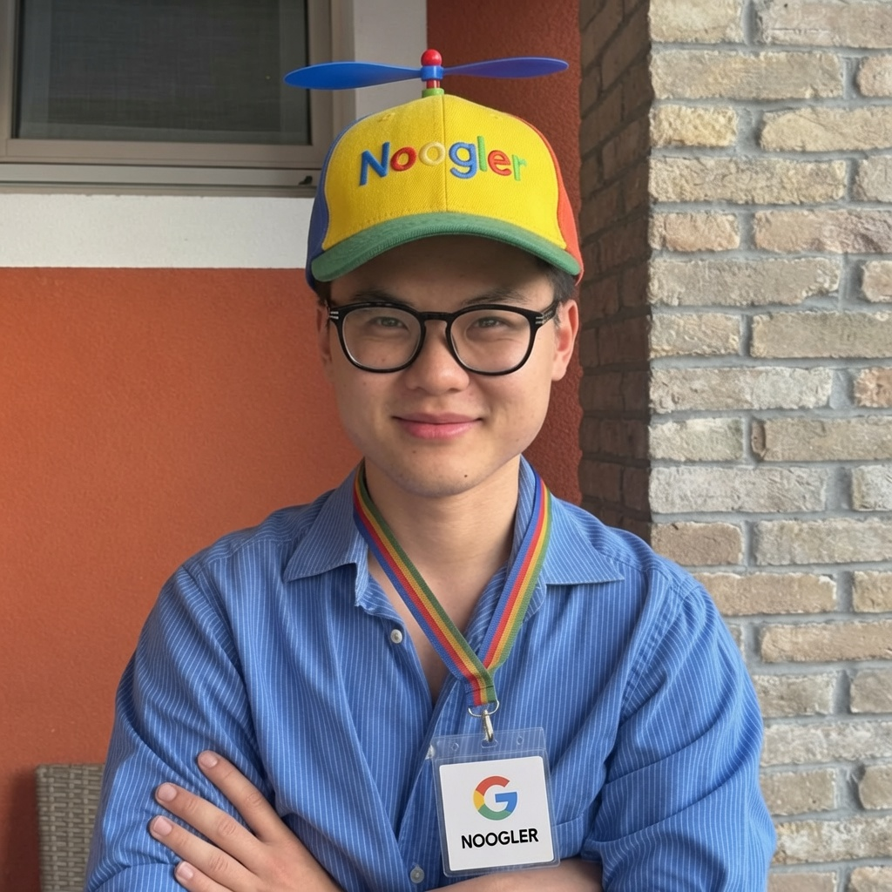
RECOMMENDER SYSTEMS · INDIVIDUAL PROJECT
Thank you
Notes:
Close. Thanks.

